Slide 1


Parkinson Disease Progress Measurement using Machine Learning
By: Varun Sharma
Major: Master’s in Data Science
College of Computing & Informatics, Drexel University
Professor: Mr. Milad Toutounchian.

Slide 2

Introduction
Parkinson's Disease is a progressive neurodegenerative disorder that affects movement control.
Common symptoms include tremors, bradykinesia (slowness of movement), muscle stiffness, and postural instability.
PD results from the loss of dopamine-producing brain cells, leading to motor and non-motor symptoms.

Slide 3


Importance
Accurate monitoring of PD progression is crucial for tailored treatment plans and improved patient outcomes.
It enables healthcare professionals to adjust medications, therapies, and interventions based on individual needs.
Early detection and precise tracking of PD progression can enhance the quality of life for patients.

Slide 4

Aim
Utilizing advanced machine learning techniques to measure PD progression more accurately.
Employing Random Forest, Linear Regression, and SVR algorithms to develop predictive models.
Comparing the performance of these algorithms to identify the most effective approach for PD progress measurement.

Slide 5
Dataset Overview
Column | Data Type
subject# | Integer
age | Integer
sex | Integer
test_time | Float
motor_UPDRS | Float
total_UPDRS | Float
Jitter(%) | Float
Jitter(Abs) | Float
Jitter:RAP | Float
Jitter:PPQ5 | Float
Jitter:DDP | Float
Shimmer | Float
Shimmer(dB) | Float
Shimmer:APQ3 | Float
Shimmer:APQ5 | Float
Shimmer:APQ11 | Float
Shimmer:DDA | Float
NHR | Float
HNR | Float
RPDE | Float
DFA | Float
PPE | Float
The dataset consists of 5,875 rows and 22 columns.
Missing Values: The dataset contains no missing values.

Slide 6

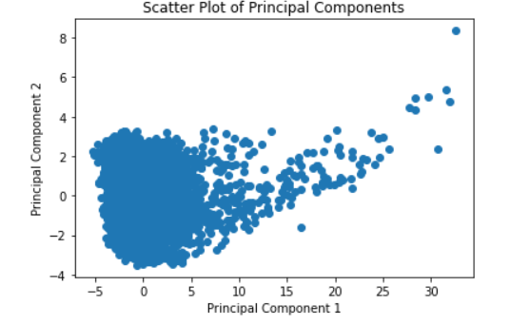
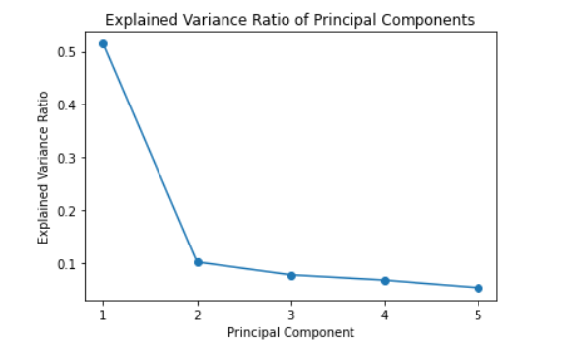
Exploratory Data Analysis (EDA) Highlights

Slide 7
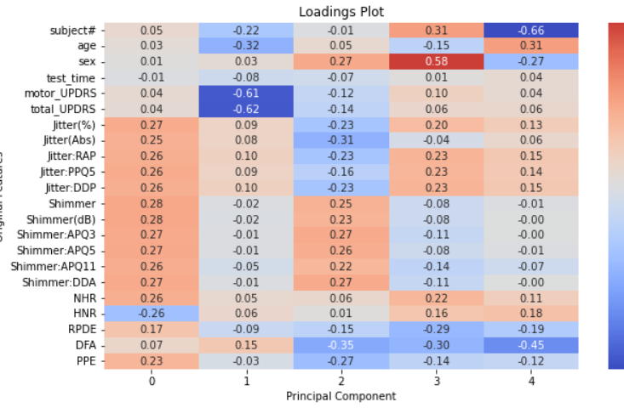
Loadings Plot

Slide 8
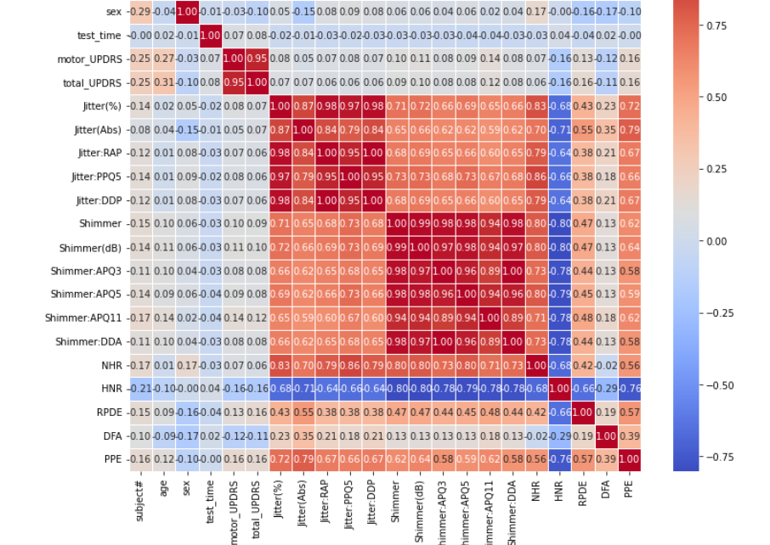
Correlation Analysis

Slide 9
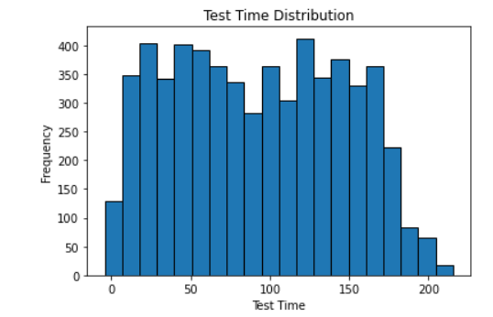
Test Time Distribution

Slide 10
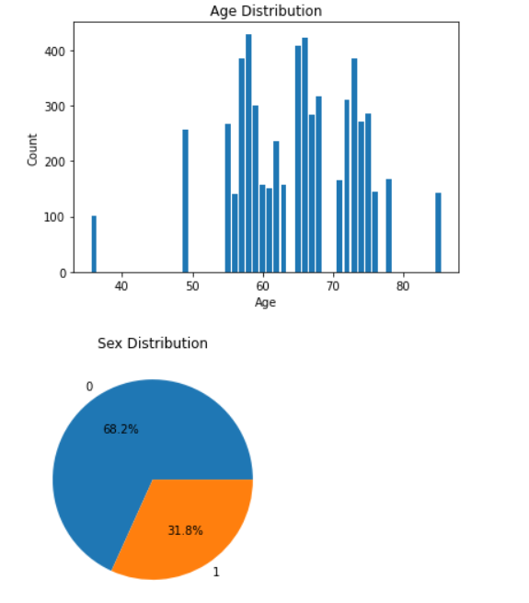
Age & Sex Distribution

Slide 11
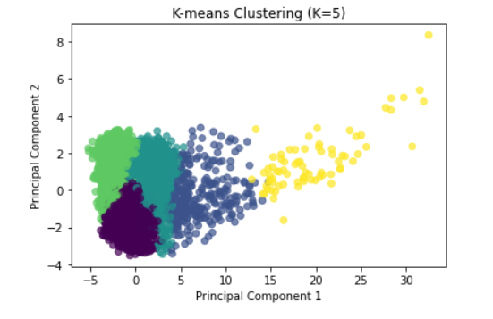
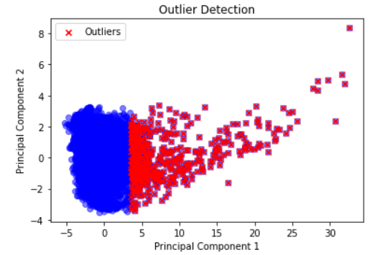
K-means Clustering & Outlier Detection

Slide 12

Feature Engineering
Principal Component Analysis (PCA):
PCA is a dimensionality reduction technique that transforms high-dimensional data into a lower-dimensional space.
It preserves the most important information in the data by finding orthogonal principal components.
Helps in reducing multicollinearity and improving model efficiency.

Slide 13

Feature Selection
Tree-based:
motor_UPDRS: 0.909069
age: 0.031284
test_time: 0.012776
sex: 0.004734
Shimmer:APQ11: 0.002643 ...
Lasso:
motor_UPDRS: 1.222791
sex_0: 0.578398
sex_1: 0.578043
age: 0.058842
HNR: 0.020882 ...
Most influential features:
motor_UPDRS, age, test_time, sex, Shimmer:APQ11
Used for model training to achieve better accuracy and interpretability.

Slide 14
Random Forest Algorithm
Ensemble learning technique based on decision trees.
Handles non-linearity, estimates feature importance, and mitigates overfitting.
PD Progress Measurement:
Features: motor_UPDRS, age, test_time, sex, Shimmer:APQ11.
Applied Random Forest for training and predicting PD progression.
Evaluation Metrics:
Used RMSE and R² to measure model performance.

Slide 15
Linear Regression Algorithm
Supervised learning for predicting continuous values.
Model linear relationship between target and features.
Simplicity and Interpretability:
Simple and interpretable.
Coefficients show feature influence on the target.
PD Progress Measurement:
Features: motor_UPDRS, age, test_time, sex, Shimmer:APQ11.
Applied Linear Regression for training.
Evaluation Metrics:
Used RMSE and R² to assess model performance.

Slide 16
Support Vector Regression (SVR) Algorithm
Supervised learning for regression tasks.
Finds a hyperplane within an ε-tube around target values.
Kernel Trick and Regularization:
Kernel Trick: Handles non-linear relationships between features and target.
Regularization: Controls ε-tube width with C and ε parameters.
PD Progress Measurement:
Features: motor_UPDRS, age, test_time, sex, Shimmer:APQ11.
Applied SVR with appropriate kernel for training.
Evaluation Metrics:
Used RMSE and R² for model performance assessment.

Slide 17
Comparative Analysis of Models
SVR with Tree-Based Feature Importance:
Strengths: Decent performance (MSE: 10.76, R²: 0.90).
Weaknesses: Lower performance compared to Random Forest.
Random Forest with Tree-Based Feature Importance:
Strengths: Excellent performance (MSE: 0.04, R²: 0.999).
Weaknesses: Potential overfitting.
MLP with Tree-Based Feature Importance:
Strengths: Good performance (MSE: 1.80, R²: 0.98).
Weaknesses: Computationally expensive.

Slide 18
Comparative Analysis of Models (Contd.)
4. SVR with Lasso Feature Importance:
Strengths: Reasonable performance (MSE: 12.63, R²: 0.89).
Weaknesses: Lower performance compared to Random Forest with Lasso.
5. Random Forest with Lasso Feature Importance:
Strengths: Excellent performance (MSE: 0.12, R²: 0.999).
Weaknesses: Potential overfitting.
6. MLP with Lasso Feature Importance:
Strengths: Good performance (MSE: 10.32, R²: 0.91).
Weaknesses: Computationally expensive, prone to overfitting.
Overall, Random Forest with Tree-Based Feature Importance (Model 2) appears most robust due to its excellent performance, but model selection depends on specific requirements and constraints.

Slide 19
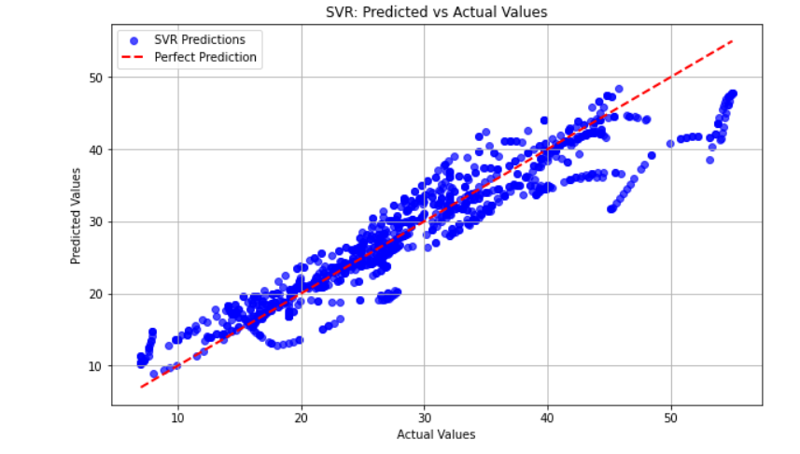
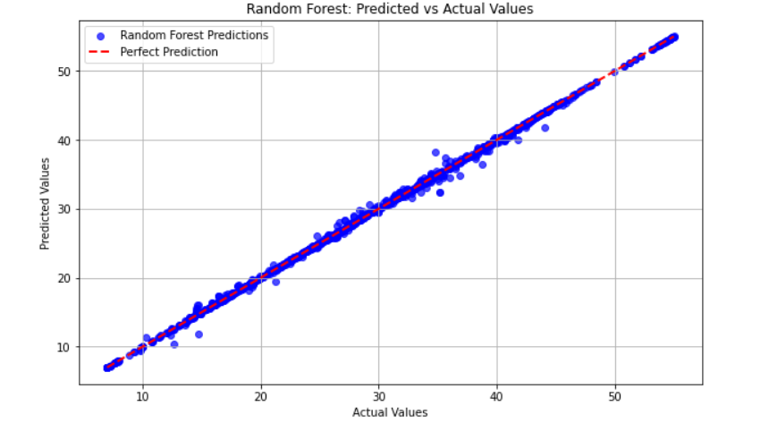
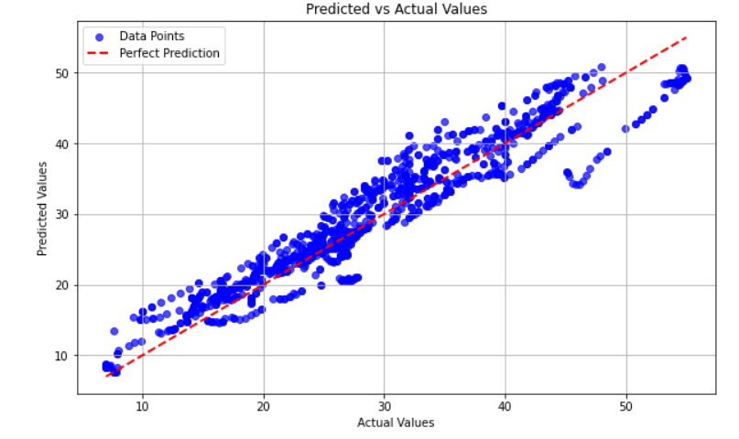
Model Results: Actual vs Predicted Values (Lasso)

Slide 20
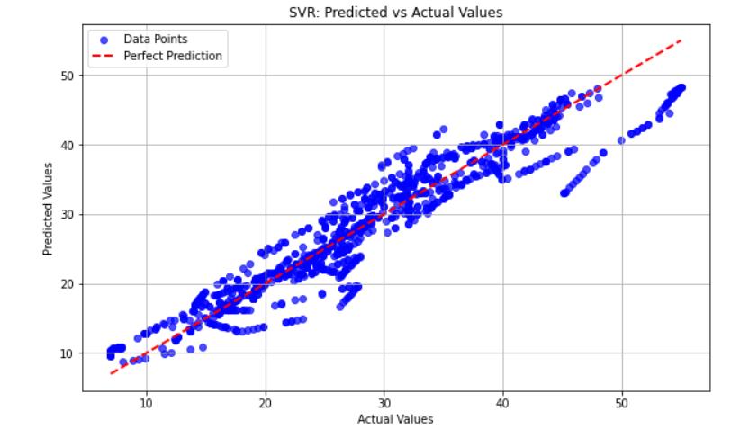
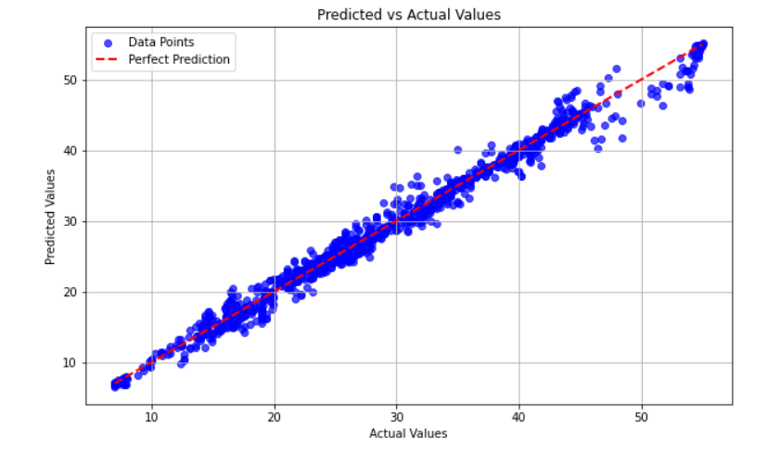
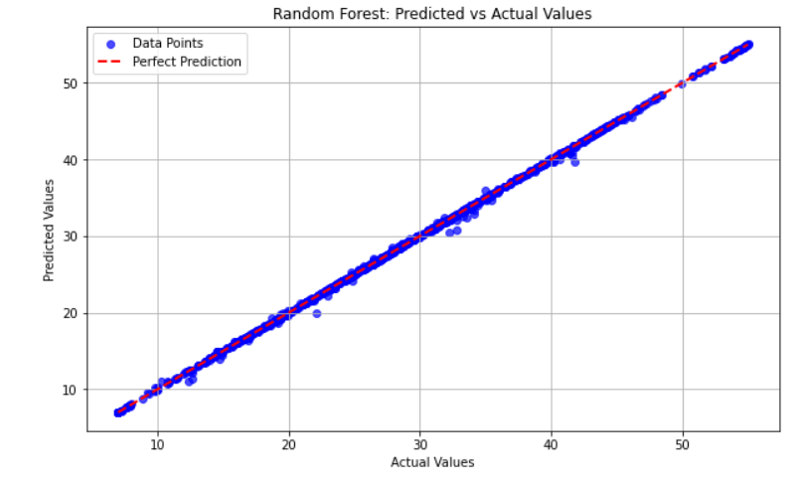
Model Results: Actual vs Predicted Values (Tree Based)

Slide 21
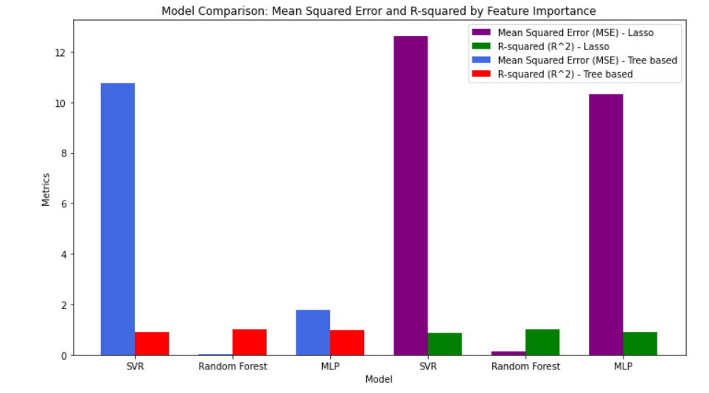
Model Comparison: Mean Squared Error and R-squared by Feature Importance

Slide 22

Conclusion
Key Findings:
The study aimed to measure Parkinson's Disease (PD) progression using various machine learning algorithms.
Three algorithms were evaluated: SVR, Random Forest, and MLP.
Tree-based feature importance and Lasso were used for feature selection.
Most Effective Algorithm:
Random Forest with Tree-Based Feature Importance (Model 2) performed exceptionally well.
It achieved the lowest Mean Squared Error (MSE: 0.04) and highest R-squared (R²: 0.999).
Random Forest proved superior in capturing complex patterns and avoiding overfitting.

Slide 23

Limitations & Future Work
The study is limited by the dataset size and features used for modeling.
Exploration of larger datasets and additional features may enhance model performance.
Further research can investigate other advanced machine learning algorithms for comparison.
External validation with different cohorts can validate the generalizability of the models.
Overall, Random Forest with Tree-Based Feature Importance showed the best performance for PD progress measurement. However, to strengthen the study's conclusions, further investigation and validation with larger datasets and different algorithms are recommended.

Slide 24
Acknowledgement
I am deeply grateful to Professor Milad for his invaluable guidance and support throughout this research. His mentorship and resources have been instrumental in its successful completion. I appreciate his dedication to fostering an intellectually stimulating environment, which has inspired me to strive for excellence. Thank you, Professor Milad, for your belief in my abilities and for making this journey a rewarding experience.

Slide 25
References
Olanow, C. W., Stern, M. B., & Sethi, K. (2009). The scientific and clinical basis for the treatment of Parkinson disease (2009). Neurology, 72(21 Suppl 4), S1-136.
Jankovic, J. (2008). Parkinson's disease: clinical features and diagnosis. Journal of Neurology, Neurosurgery & Psychiatry, 79(4), 368-376.
Postuma, R. B., Berg, D., Stern, M., Poewe, W., Olanow, C. W., Oertel, W., ... & Deuschl, G. (2015). MDS clinical diagnostic criteria for Parkinson's disease. Movement Disorders, 30(12), 1591-1601.
Lebedev, A. V., Westman, E., & Simmons, A. (2014). Large-scale resting state network correlates of cognitive impairment in Parkinson's disease and related dopaminergic deficits. Frontiers in Systems Neuroscience, 8, 45.
Hoehn, M. M., & Yahr, M. D. (1967). Parkinsonism: onset, progression, and mortality. Neurology, 17(5), 427-442.

